Slide 1
Deploying your Azure solution using Azure DevOps and ARM
Teemu Tapanila

Slide 2


Teemu Tapanila
Chief Executive Officer Teemu.Tapanila@cloudborealis.fi
Azure & Azure DevOps expert from Finland
Working with Azure since 2011
Microsoft Azure MVP since 2014
Speaker & Trainer

Slide 3
Background
This is opinionated talk
Opinions on this presentation are based on my experiences with real teams
Small startup teams (2-7 developers)
Enterprise Teams (50+ teams with 5-200 developers in each team)

Slide 4
Value of Azure Resource Manager (ARM) Templates
Curve on learning ARM is pretty high and it’s large investment to learn it -> Most people don’t invest on learning writing ARM templates well
The value of ARM is only increases when you are using it to deploy larger applications
more than 7-9 Azure services
lots of configurations
Dependencies
Multiple environments

Slide 5
ARM vs Powershell
When creating single resources powershell is amazing tool and will serve you well
When creating complex azure environments where you do updates often and have different environments in different state doing the update with powershell will be hard

Slide 6
ARM vs Terraform
Using ARM or Terraform is a preference question
There’s multiple arguments for and against both technologies
The only thing that really matter is that you are using Infrastructure as Code (IaC)!

Slide 7
ARM Best Practices
ARM templates should be split into multiple small pieces – same principle as with the code
ARM templates are easier to share when they are small and everyone is following one practice to build them
ARM Parameter naming should follow company wide standard so projects can share templates
Resource naming needs to be decided before any ARM templates are created!
Tagging is easy to change when you do it with ARM Templates

Slide 8
Example naming convention and tagging
Resource type | Resource name prefix
Resource group | rg-
Availability set | avail-
API management service | api-
Virtual network | vnet-
Virtual network gateway | vnetgw-
Gateway connection | cn-
Subnet | snet-
Network security group | nsg-
Route table | route-
Tag Name | Key | Example value
Application name | ApplicationName | {app name}
Approver name | Approver | {email}
Budget approved | BudgetAmount | {$}
Business unit | BusinessUnit | FINANCE, MARKETING, {Product Name}, CORP, SHARED
Cost center | CostCenter | {number}
https://docs.microsoft.com/en-us/azure/cloud-adoption-framework/ready/azure-best-practices/naming-and-tagging

Slide 9
Structure of example
FullDeploy.json – Master Template
FullDeploy.parameters.json – Parameters for deployment
SignalR.json – Template to create SignalR instance
AzureMap.json – Template to create Azure Map instance

Slide 10
ARM Validation
All changes to ARM template are made with pull request when we are talking about Develop or Master branch
Before pull request can be accepted we will deploy the template to a new subscription/resource group.

Slide 11
Demo

Slide 12
Branching strategy
Master (This is what’s currently released to Production)
Only with pull requests
Development (This is what’s currently released to Development)
Only with pull requests

Slide 13
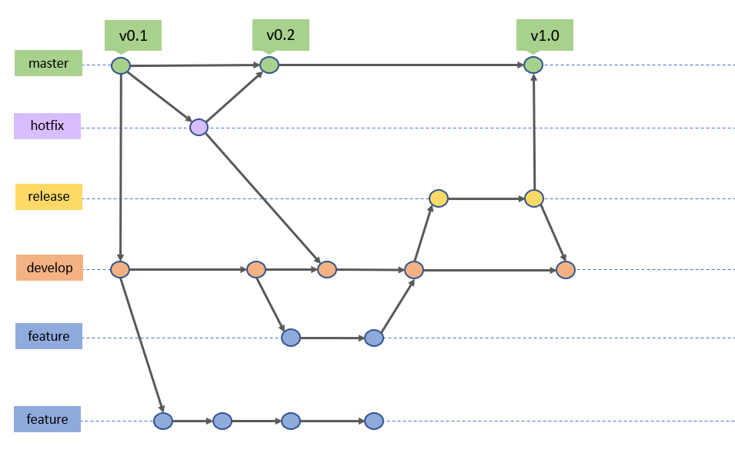
Git Flow Branching

Slide 14
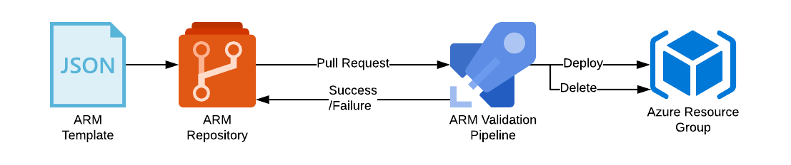
Diagram of what are we going to do

Slide 15
Demo

Slide 16
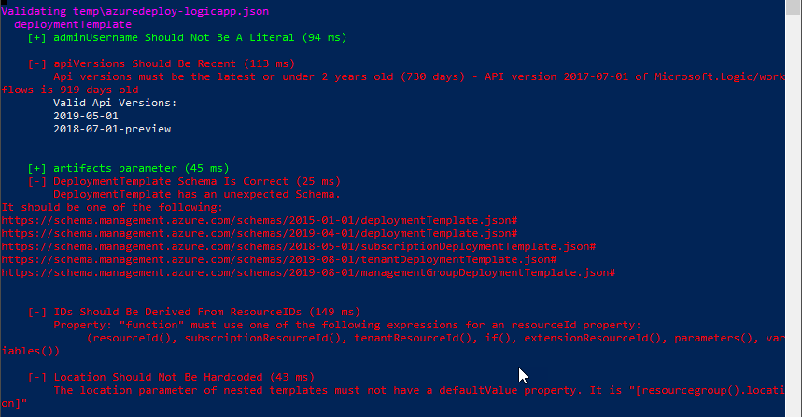
ARM-TTK (ARM Template validation)

Slide 17
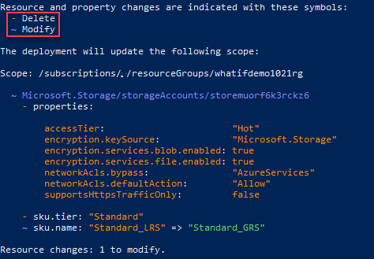
What-if on Pull Request

Slide 18
Questions?

Slide 19
Thank you!
@TapanilaT
Teemu.Tapanila@cloudborealis.fi
bit.ly/TeemuARM

